Slide 1


Changing the Perspective: Uncertainty as an Opportunity – how to go Forward in Life
European Actuarial Conference
Rome, 7th of June 2024
Daniela D’Andrea, Marco Bozzolo
Notes:
Changing title of your presentation in Rome to this: Changing the Perspective: Uncertainty as an Opportunity – how to go Forward in Life
Using Forward in Life as cover slide for the presentation
Adding key Forward in Life messages and the overall spirit into your presentation?

Slide 2

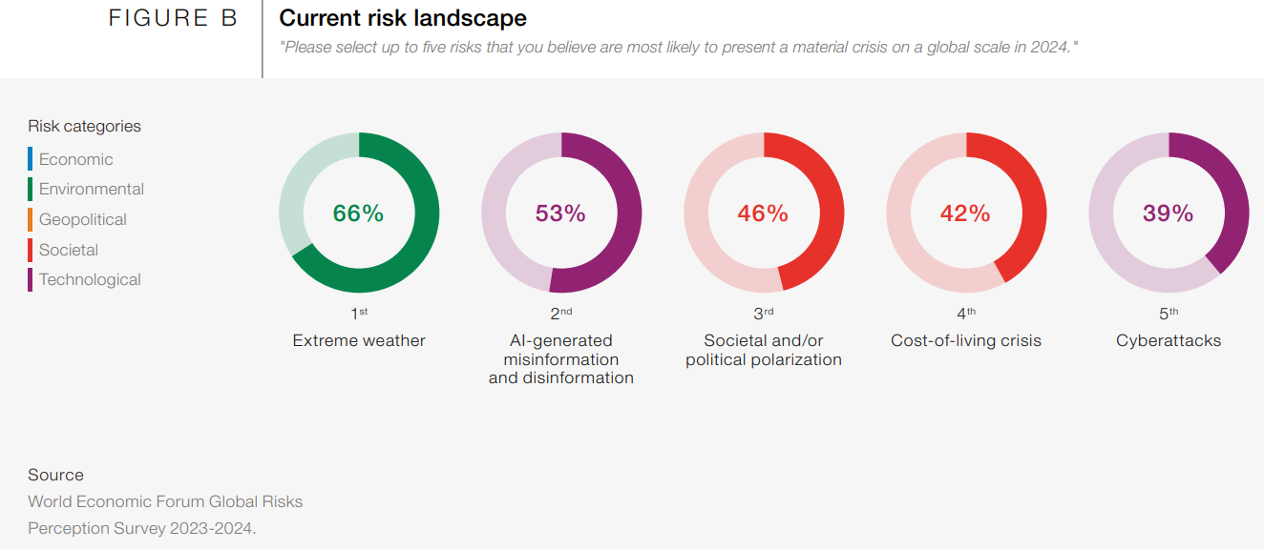
The Global Risks Report 2024
WEF_The_Global_Risks_Report_2024.pdf (weforum.org)

Slide 3
“Sometimes overcoming a challenge is as simple as changing the way you think about it.”
Anonymous
ECA 2024

Slide 4
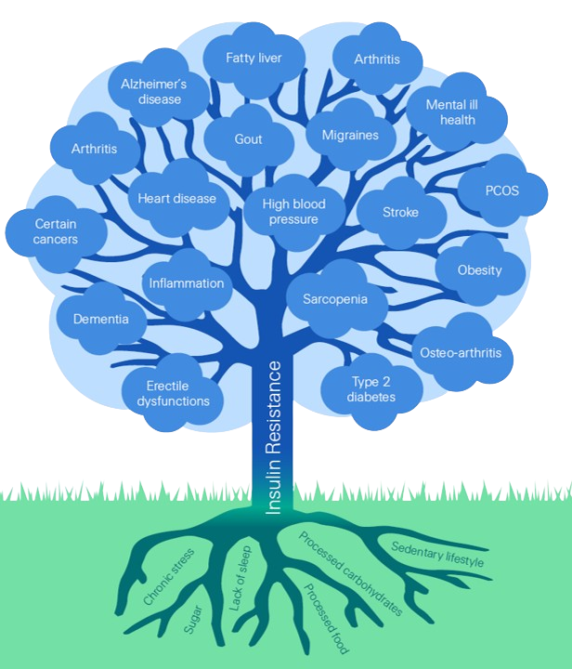
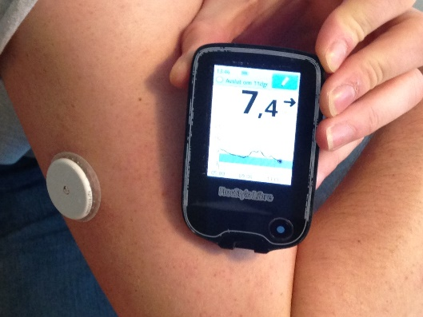
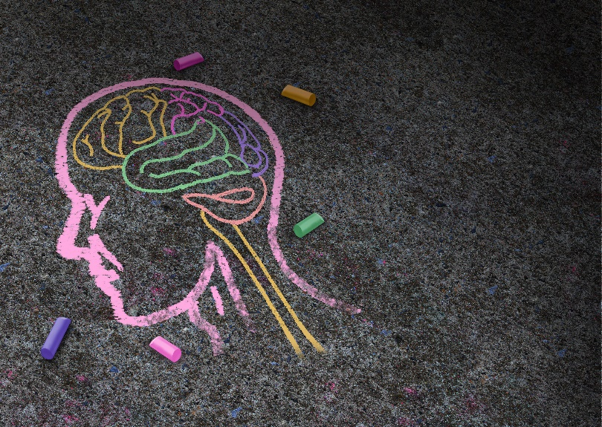
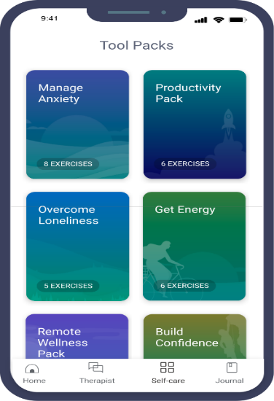
Digital interventions on metabolic and mental health
Root cause of
poor metabolic health is
insulin resistance
which affects 89% of people
Continuous glucose monitors
Mental health % of total claims is:
5% for mortality
5%-20% for DI
AI Chatbots
Notes:
89% of developed country deaths now considered to be due to NCDs
Met S not jus CV risk
But many other chronic conditions
And importantly CANCER, mental ill health and neurodegenerative conditions. and we now far better understand the biology and cellular mechanisms. its not just epidemiological associational studies

Slide 5
# Artificial Intelligence 1.0
AI_Risk = function(
transparency,
bias and discrimination,
privacy and ethics,fakes,
polarization, addiction,
security, influencer,
complexity)
AI_Opportunities = function(
reduce human error,
solve complex problems,
facilitates quick decisions,
improves processes and workflows,
24/7)
Notes:
Alan Turing
AI technology is widely used throughout industry, government, and science. Once something becomes useful enough and common enough it's not labeled AI anymore
Applications include advanced web search engines (e.g., Google Search);
recommendation systems (used by YouTube, Amazon, and Netflix);
interacting via human speech (e.g., Google Assistant, Siri, and Alexa);
autonomous vehicles (e.g., Waymo);
generative and creative tools (e.g., ChatGPT and AI art);
and superhuman play and analysis in strategy games (e.g., chess and Go).
AI can bring a range of benefits to both consumers and insurers in the insurance industry. Eg
Greater ability to understand and model risks, thereby enhancing firms’ abilities to understand and assess risks.
(P&C) pricing and risk management
Development of new or enhanced products.
Automation and reducing the cost of serving customers.
claims processing, claims fraud detection, automated underwriting, submission intake
Expanded data and insight access
Automated audits, customer segmentation, agent’s self-servicing
Better, quicker decisions are driven by data
The right information at the right moment to the right people
Policy servicing, customer lifetime value prediction, product reccomendation

Slide 6
# Artificial Intelligence 2.0
AI_Actuary
Do Understand and own the complex models
Do Be vigilant of potential direct or indirect pricing discriminations
Do Educate the community, translate in easy language, see the potential for AI use cases across the value chain – it's no longer "only" for mathematicians
Do Own the data to be used in AI: quality, regulation (compliance, GDPR, etc), bias
Do Add value by instructing the machine, interpret/validate/review the output
Do Upskill
Do Challenge the outcome
Notes:
take-away: the role of the actuary won’t disappear in the short term due to AI, on the contrary, AI is an opportunity for actuaries to drive discussions along the entire value chain (not only pricing/RM)

Slide 7
Let's take a step back, what limits do we impose on our customers that are likely to be seen as unfair and will therefore lead to intervention?
The regulatory challenges opportunities

Slide 8
The regulatory challenges opportunities
technologies
unfair treatment
industry failures

Slide 9

The evolving actuary: from containment to contaminant, from risk calculator to calculated risk taker. Scan the horizon for long term risks: no only biometric but societal technological, geopolitical.

Slide 10




Thank you!
Forward in Life
Follow us

Slide 11
Legal notice
©2024 Swiss Re. All rights reserved. You may use this presentation for private or internal purposes but note that any copyright or other proprietary notices must not be removed. You are not permitted to create any modifications or derivative works of this presentation, or to use it for commercial or other public purposes, without the prior written permission of Swiss Re.
The information and opinions contained in the presentation are provided as at the date of the presentation and may change. Although the information used was taken from reliable sources, Swiss Re does not accept any responsibility for its accuracy or comprehensiveness or its updating. All liability for the accuracy and completeness of the information or for any damage or loss resulting from its use is expressly excluded.

