Slide 1

Climate Data and Catastrophe Modelling in Asia
March 24th, 2026

Slide 2
Agenda
01
Introduction
02
Reliable Data Sources
03
Climate Change in Cat Models
04
What we do and don’t know

Slide 3
Introduction
The Climate Change Reporting Landscape

Slide 4
The Climate Change Reporting Landscape
Introduction
International Panel on Climate Change (IPCC)
Established by the United Nations Environment Programme (UNEP) and the World Meteorological Organization (WMO) in 1988.
Six total assessments with six total Assessment Reports (AR)s delivered to date.
  Plus countless additional technical and methodology reports.
IPCC ARs are an assemblage and analysis of the vast majority of past and present peer reviewed and published scientific articles about climate change.
  The purpose is to inform governments about the state of knowledge of climate change.
  Subjects include the natural, economic and societal risks for to climate change.
https://www.ipcc.ch/about/history/

Slide 5
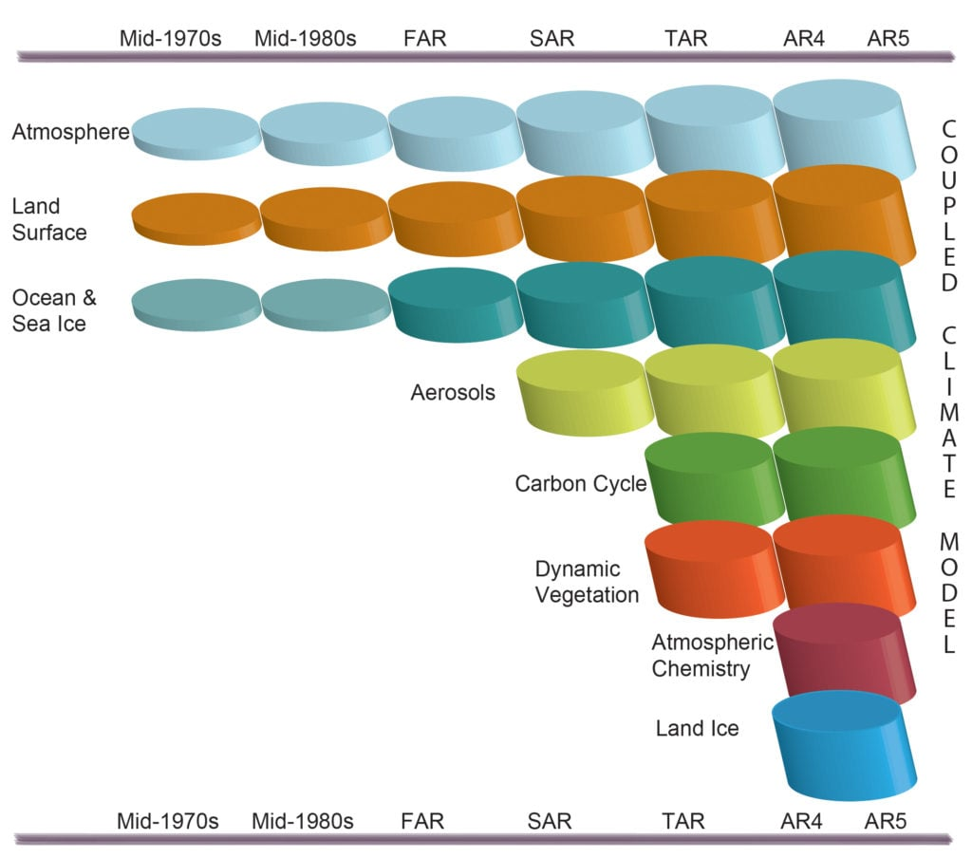
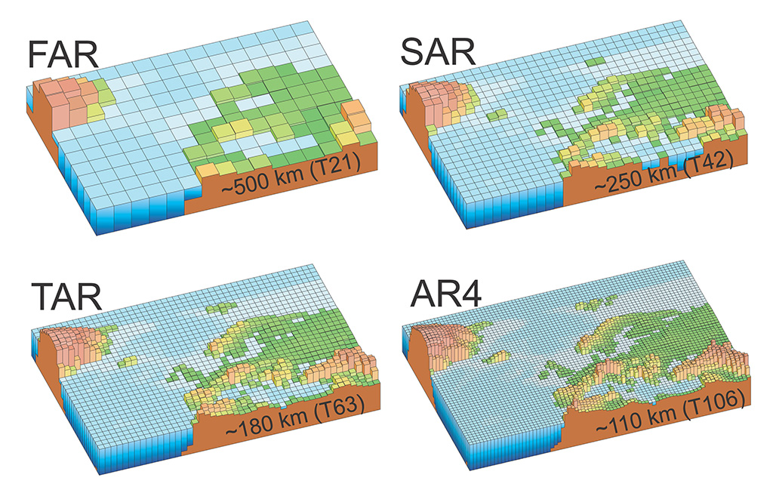
The Climate Modles
Introduction
Increasing Complexity
AR 5 (2014) -
Representative Concentration Pathway (RCP) Scenarios
AR 6 (2023) –
Shared Socioeconomic Pathway (SSP) Scenarios
https://www.ipcc.ch/site/assets/uploads/2018/02/Fig1-13-1024×904.jpg

Slide 6
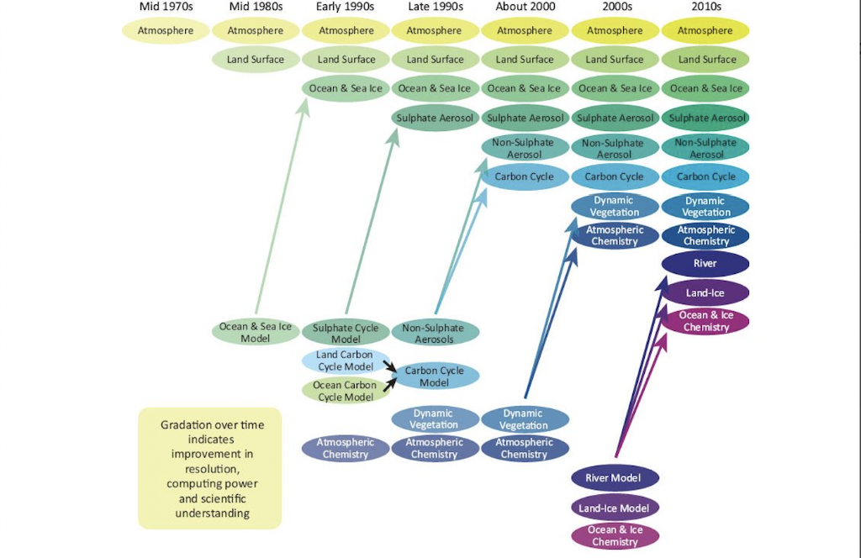
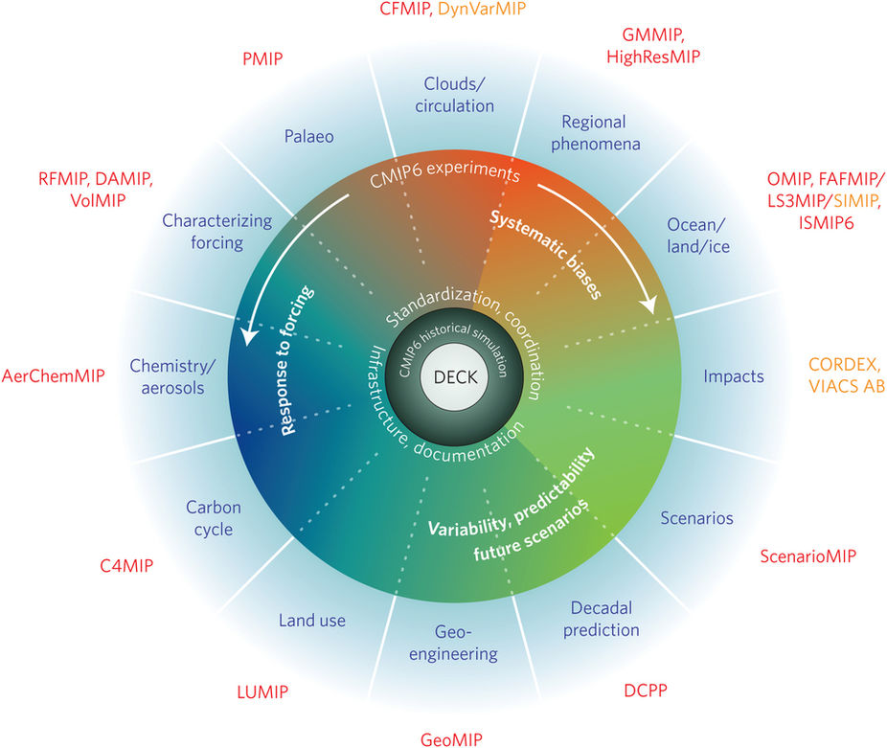
The Climate Modles
Introduction
Increasing Complexity
Coupled Model Intercomparison Project (CMIP6)

Slide 7
Reliable Data Sources
02
Where cat modelers get their information

Slide 8



Where Cat Modelers Get Their Information
Data Sources
IPCC
Scientific Journals
Government Entities
The Intergovernmental Panel on Climate Change has been the preeminent reference for international governments since the 1980s
Peer reviewed scientific journals, such as those from the American Meteorological Society, are the building blocks on which the IPCC and climate science is built.
Governments play an important role, funding and working with scientists to generate reports for free use by the scientific community

Slide 9


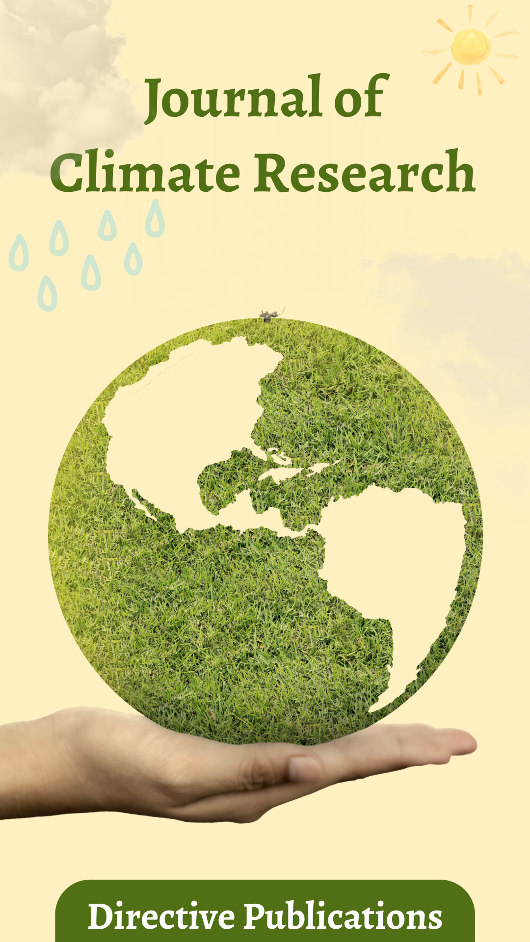











Where Cat Modelers Get Their Information
Data Sources
Scientific Journals
Government Entities
Etc.
Etc.

Slide 10
Climate Change in Cat Models
03
What Data is used and how can it be used?

Slide 11
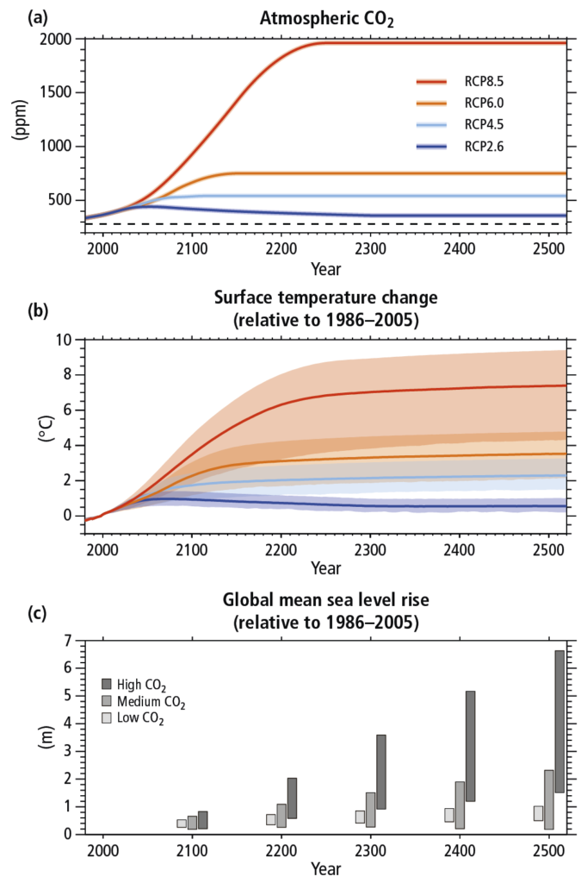
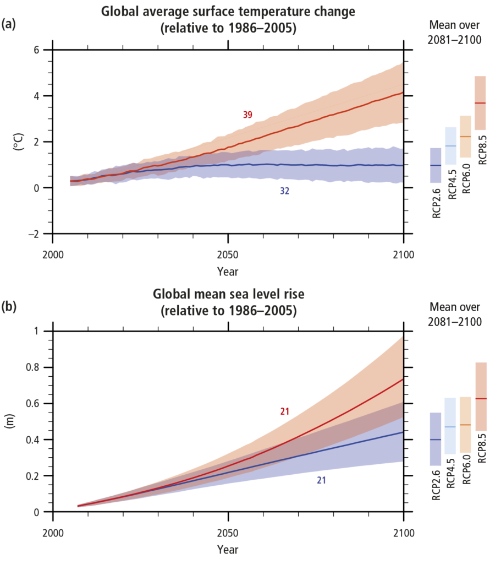
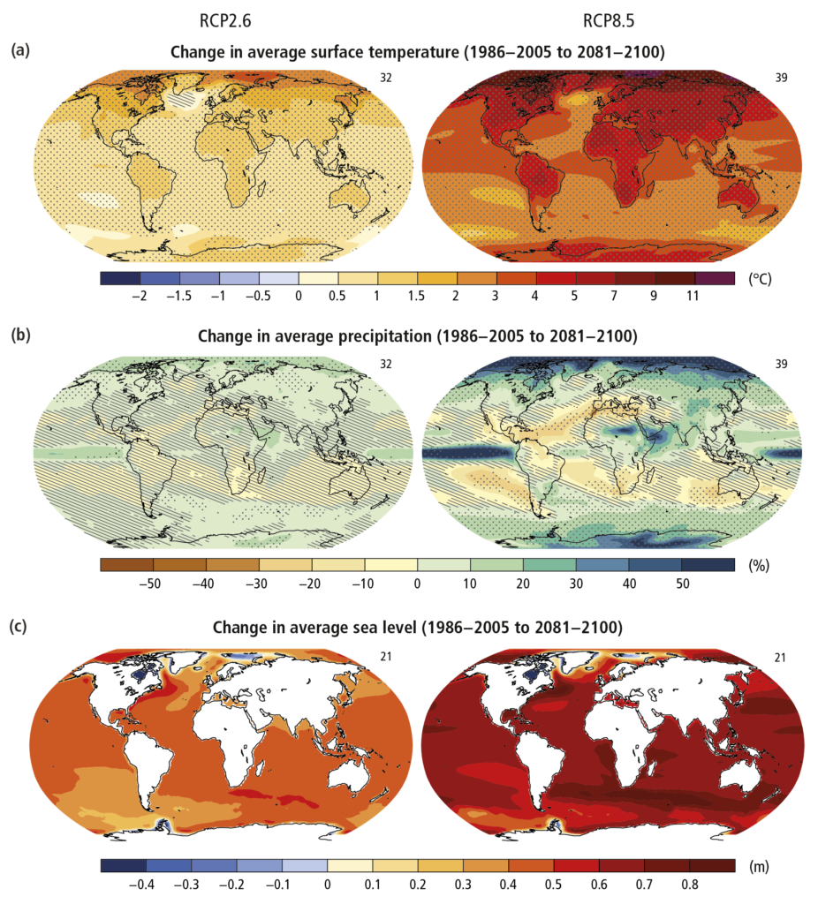
What Data is used and how can it be used?
Climate Change in Cat Models
Assessment Report 5 RCP Scenarios
https://www.ipcc.ch/report/ar5/syr/synthesis-report/

Slide 12
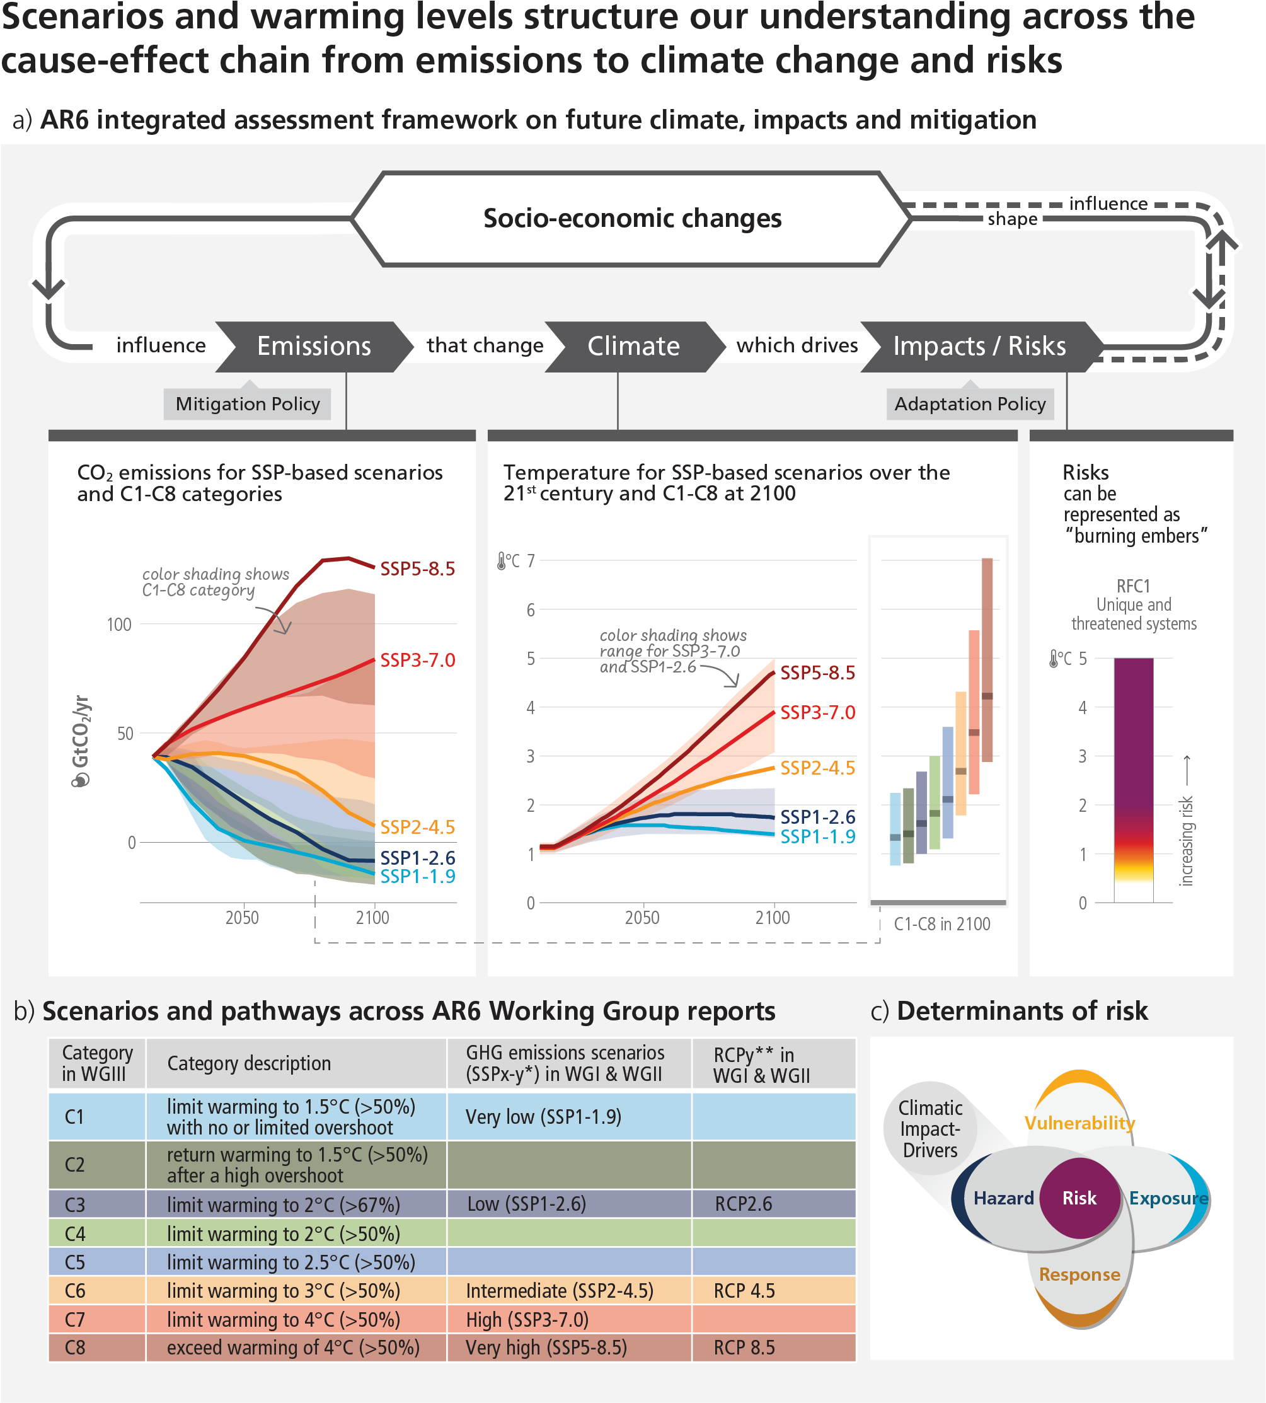
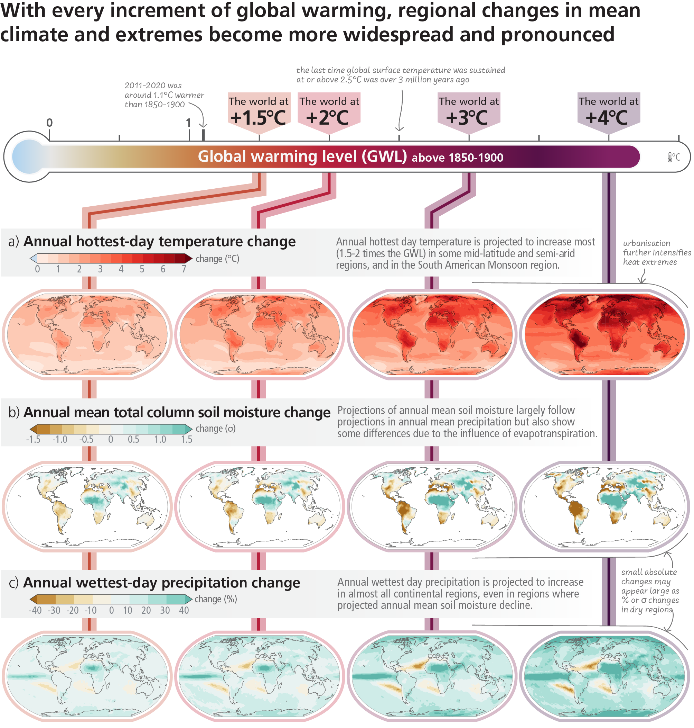
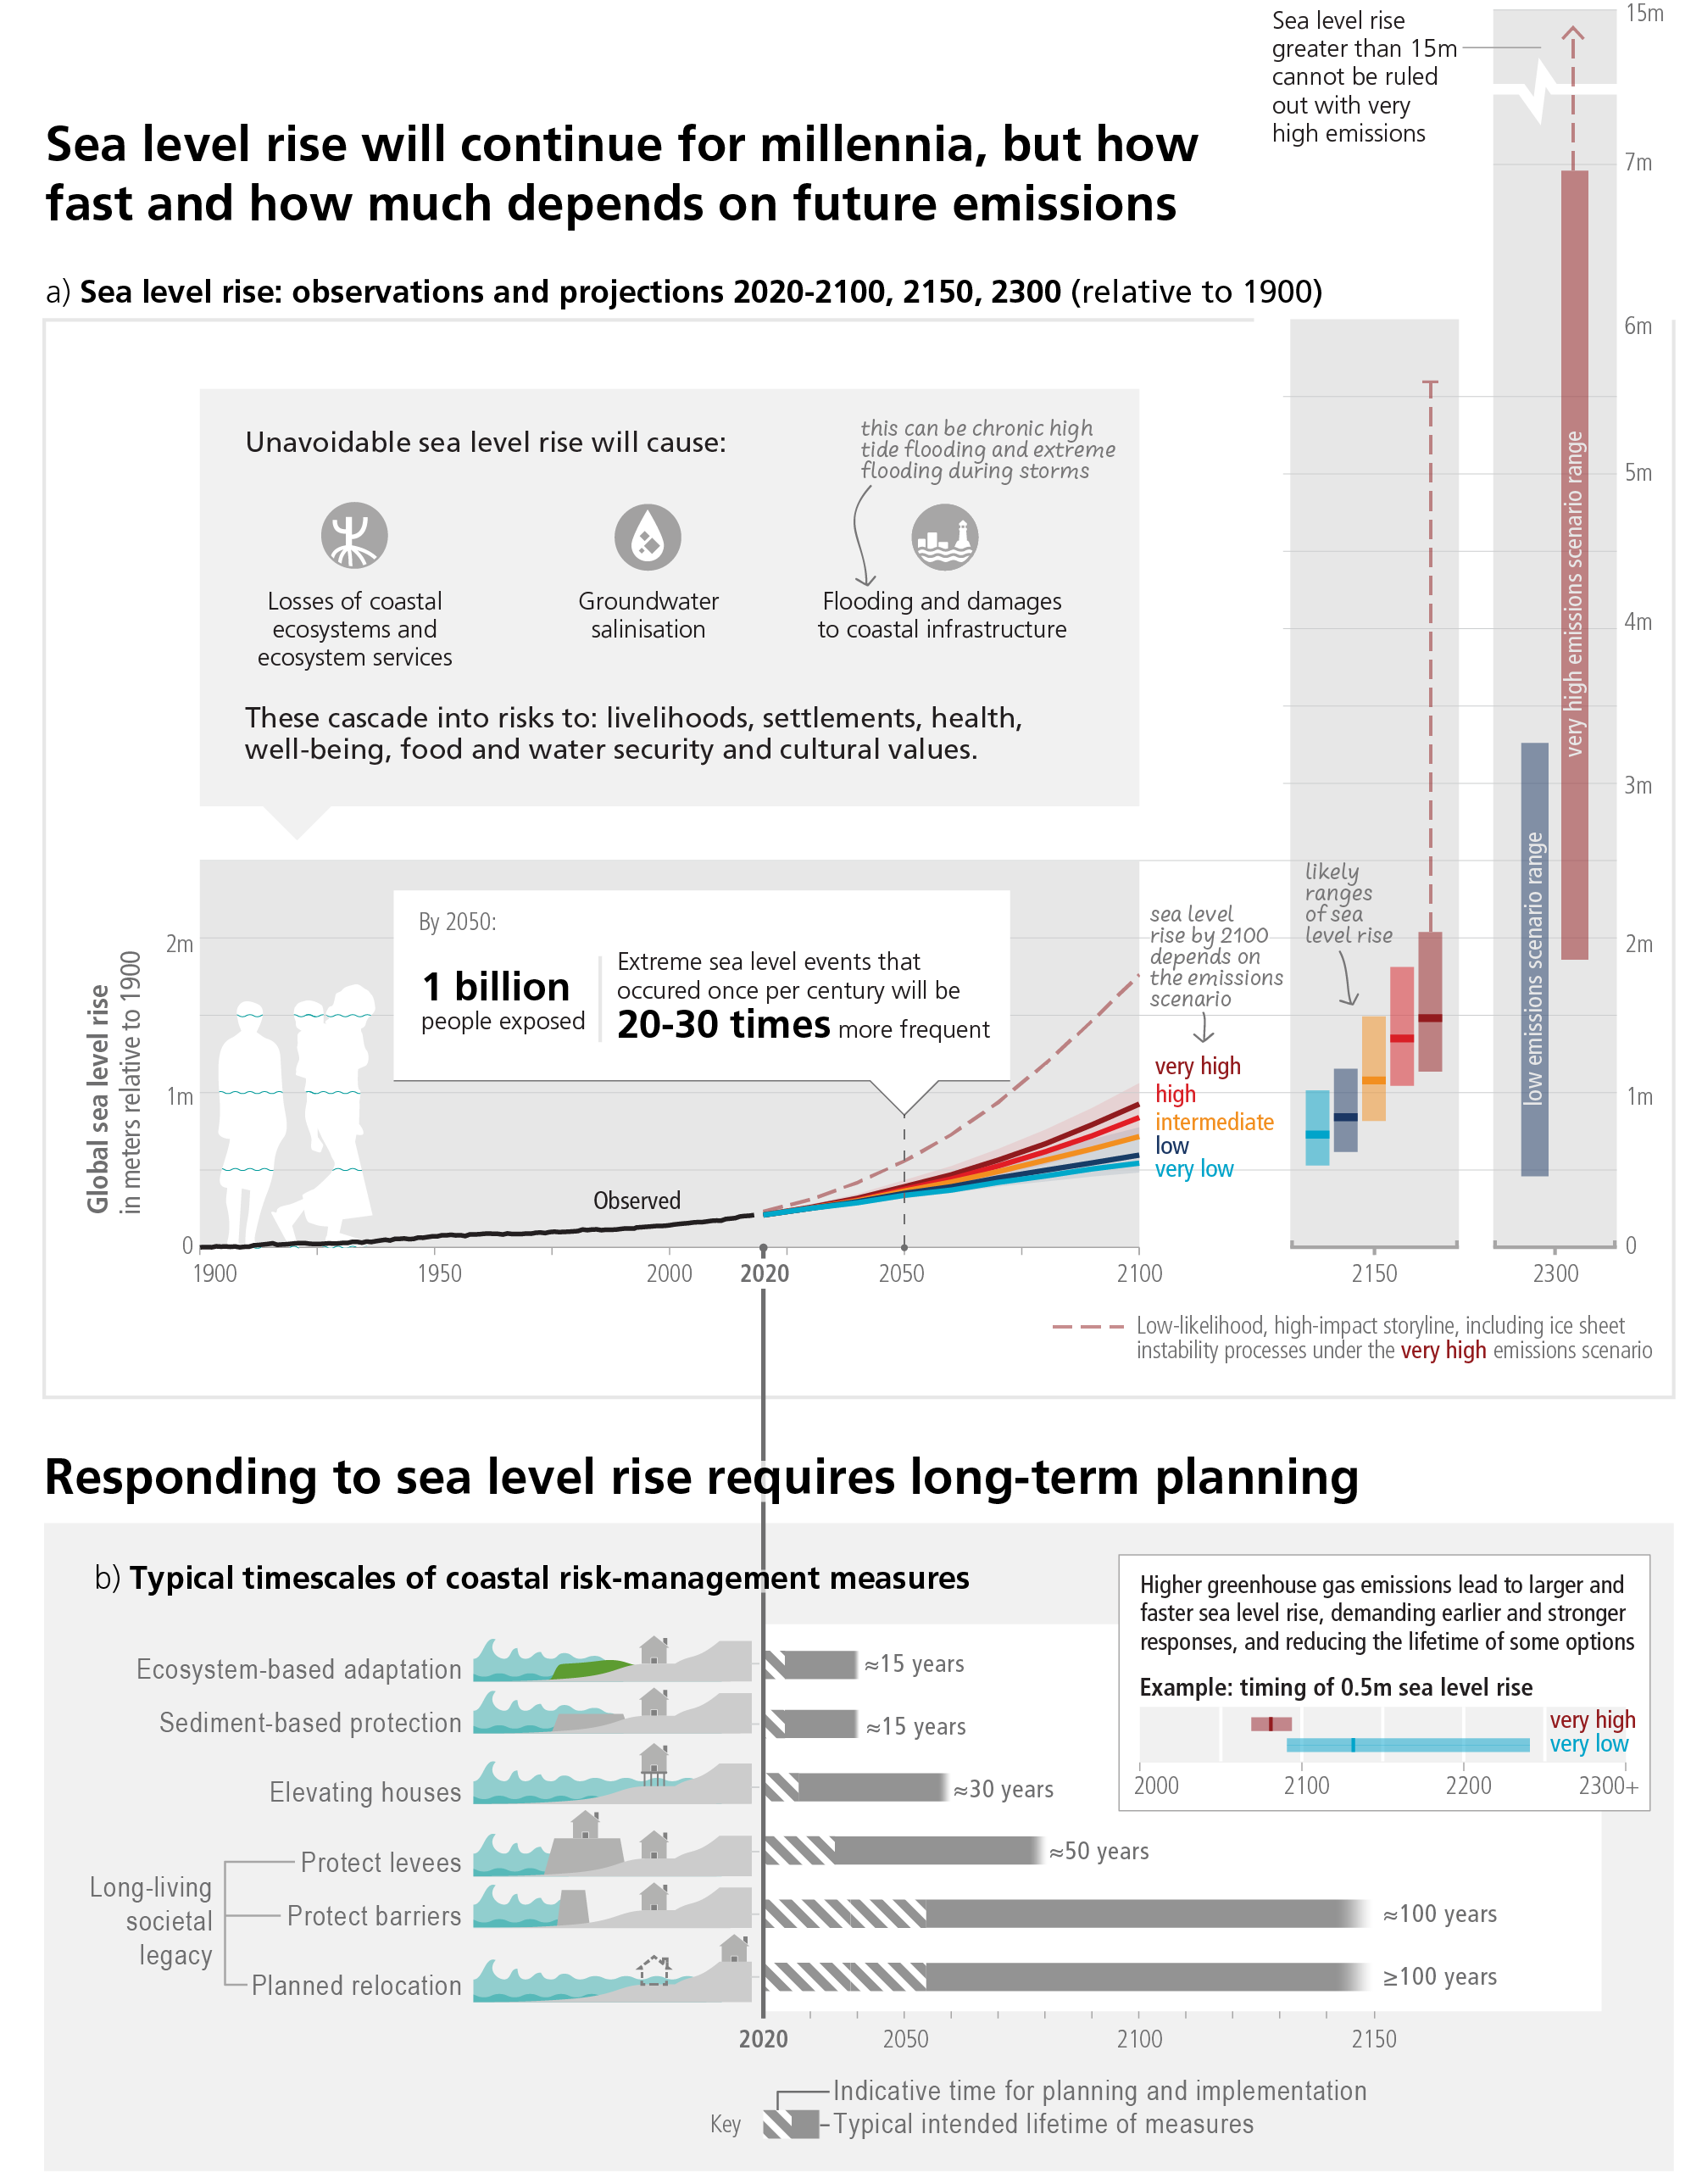
What Data is used and how can it be used?
Climate Change in Cat Models
Assessment Report 6 SSP Scenarios
https://www.ipcc.ch/report/ar6/syr/figures/

Slide 13






Climate Change and Nat-Cat Perils
Climate Change in Cat Models
Inland Flood
TC Wind
TC Surge
Precipitation changes are directly modeled within the climate models and inferred using canonical temperature to moisture equations.
Changes in TC wind can be inferred from changes in temperature, wind patterns, and sea level rise.
Sea level rise is directly modeled in climate change models.
SCS
Wildfire
Winter Storm
There is low certainty in SCS and climate change relationships with a few exceptions for Straight Line Winds
Wildfire is tied to changes in precipitation and increases in temperature, both of which are directly attainable from climate model output
There is low certainty in winter storm and climate change relationships.

Slide 14
What we do and don’t know
04
What is the scientific consensus on climate change impacts?

Slide 15
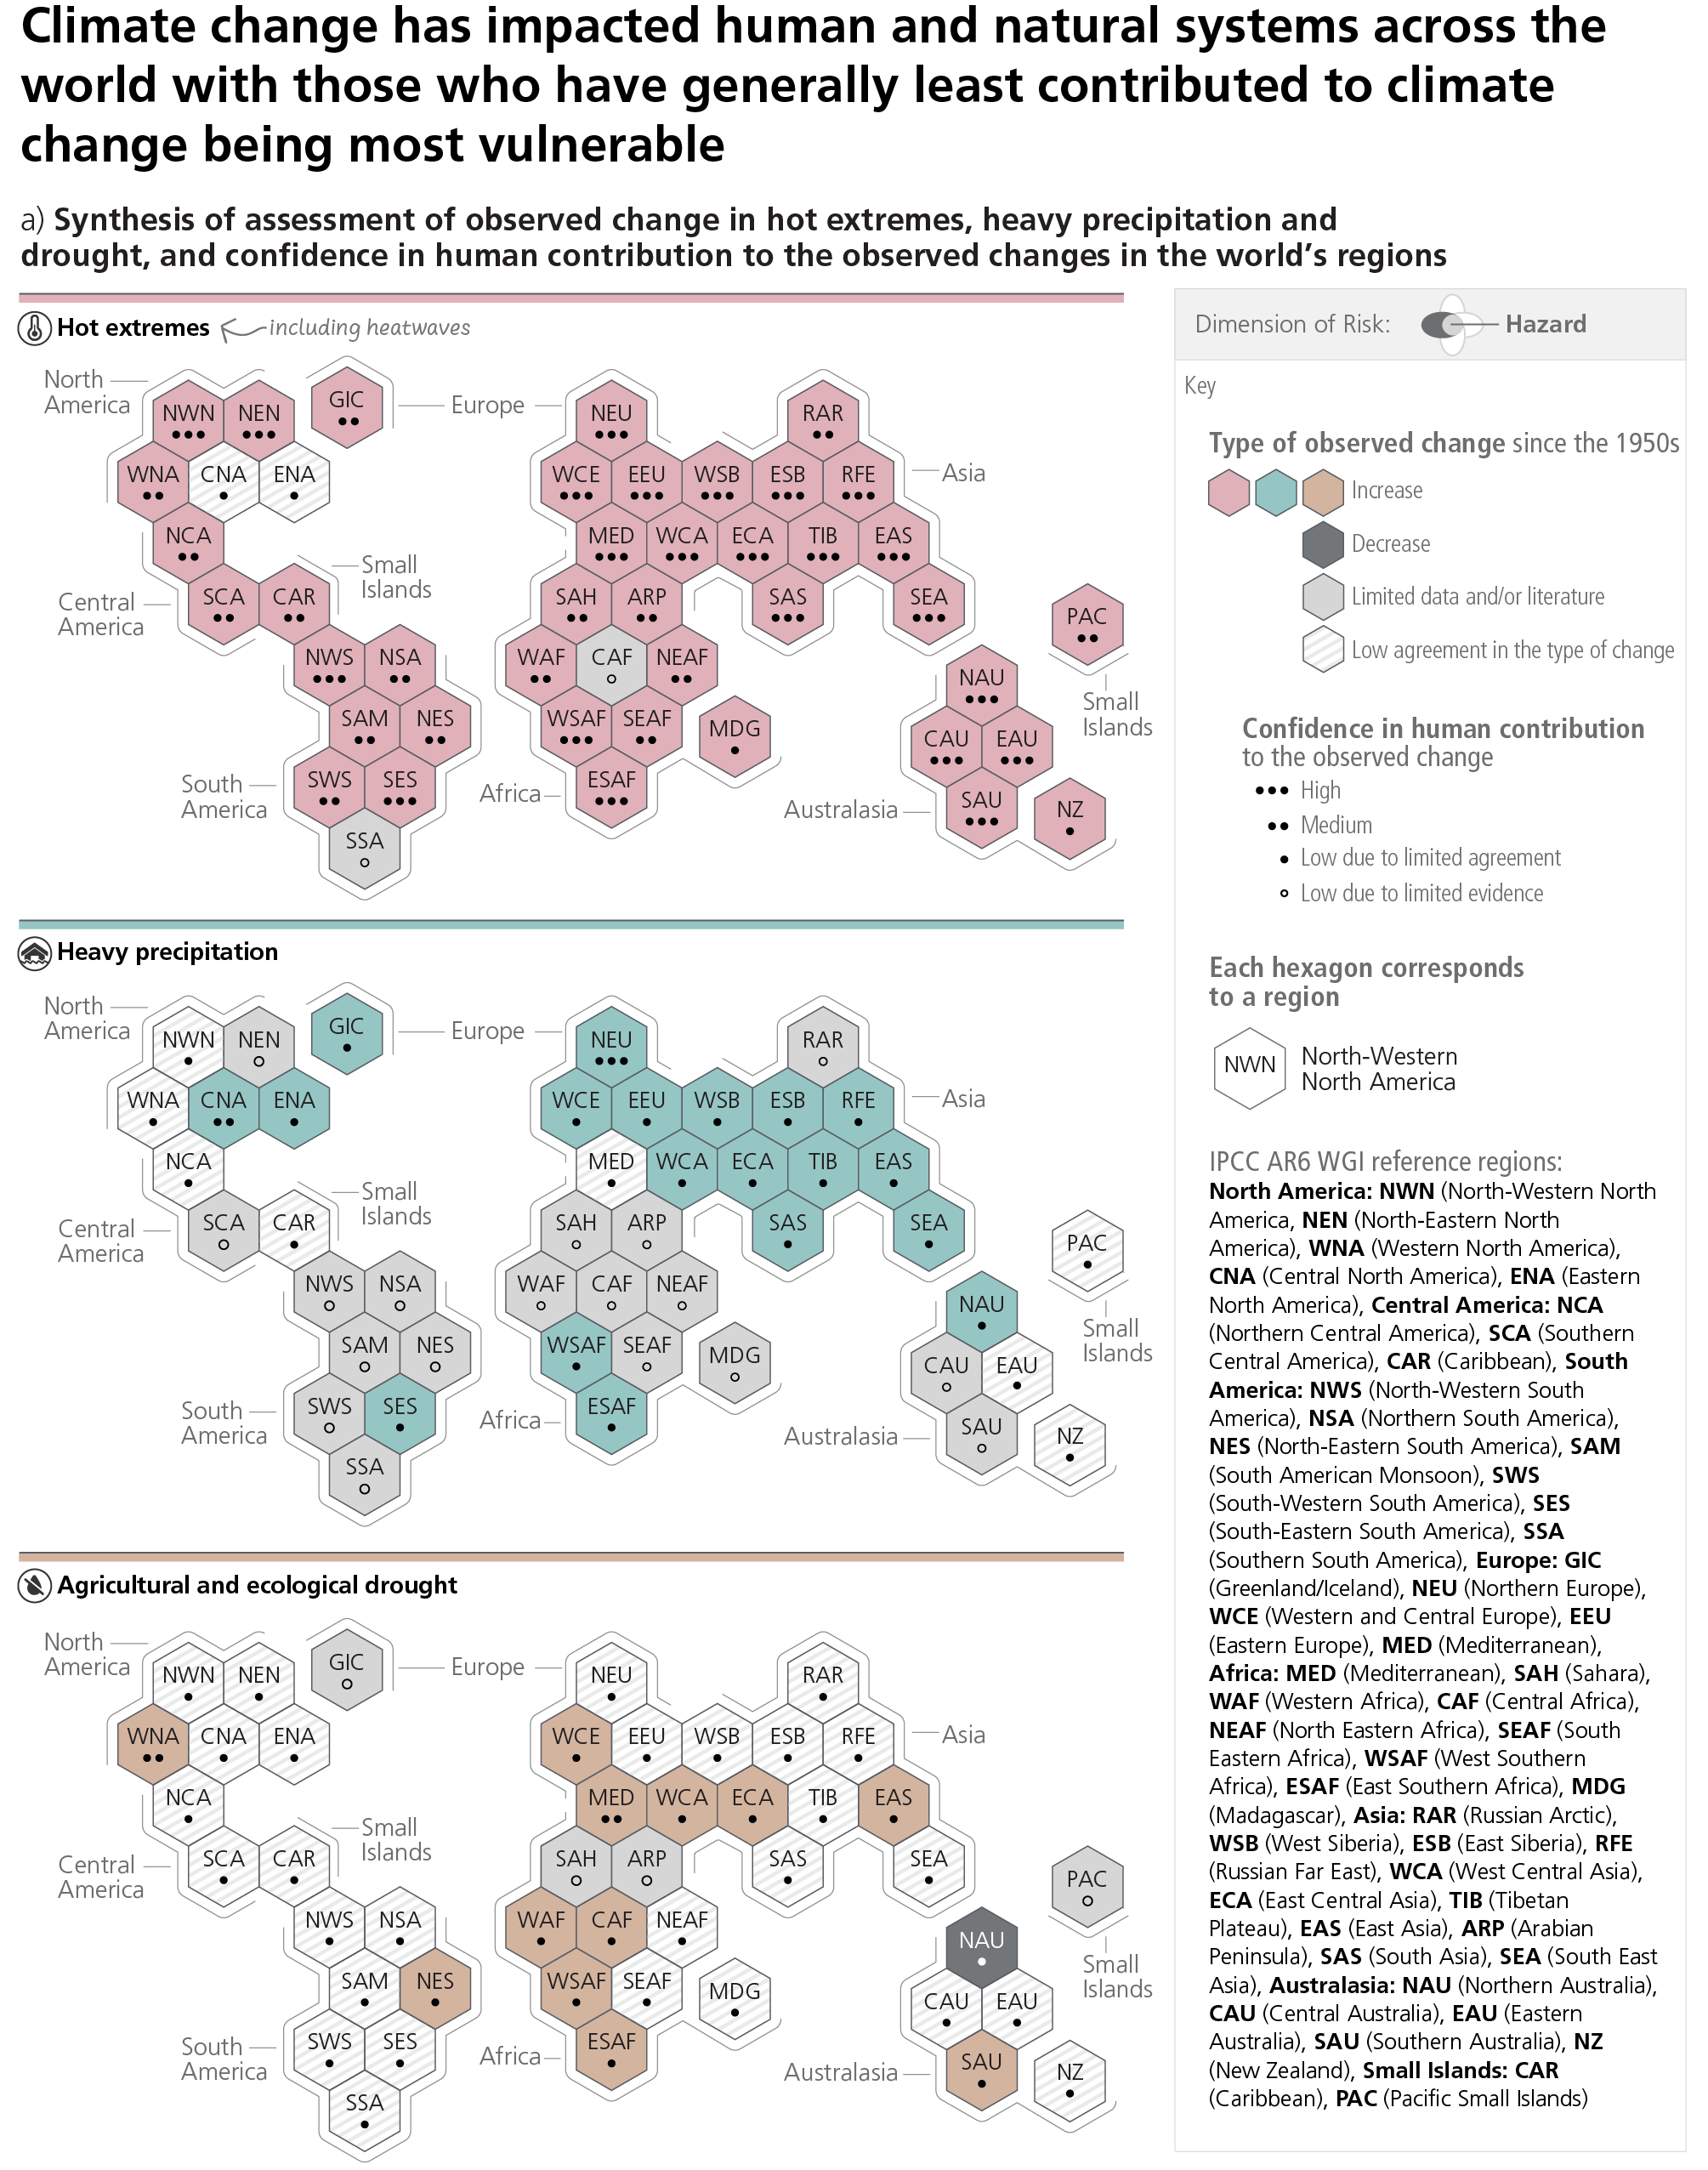
What is the scientific consensus on climate change impacts?
What we do and don’t know
https://www.ipcc.ch/report/ar6/syr/figures/figure-2-3

Slide 16
What is the scientific consensus on climate change impacts?
What we do and don’t know
https://www.ipcc.ch/report/ar6/syr/figures/figure-2-3

Slide 17
What is the scientific consensus on climate change impacts?
What we do and don’t know
https://www.ipcc.ch/report/ar6/syr/figures/figure-2-3

Slide 18
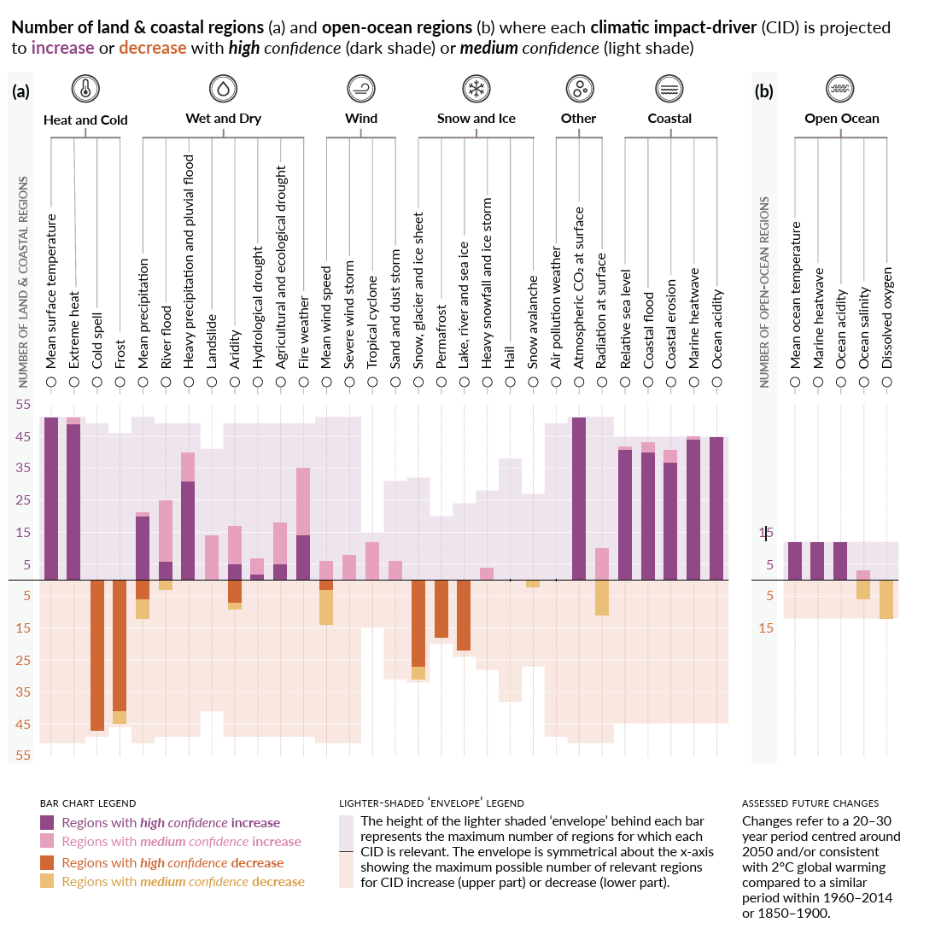
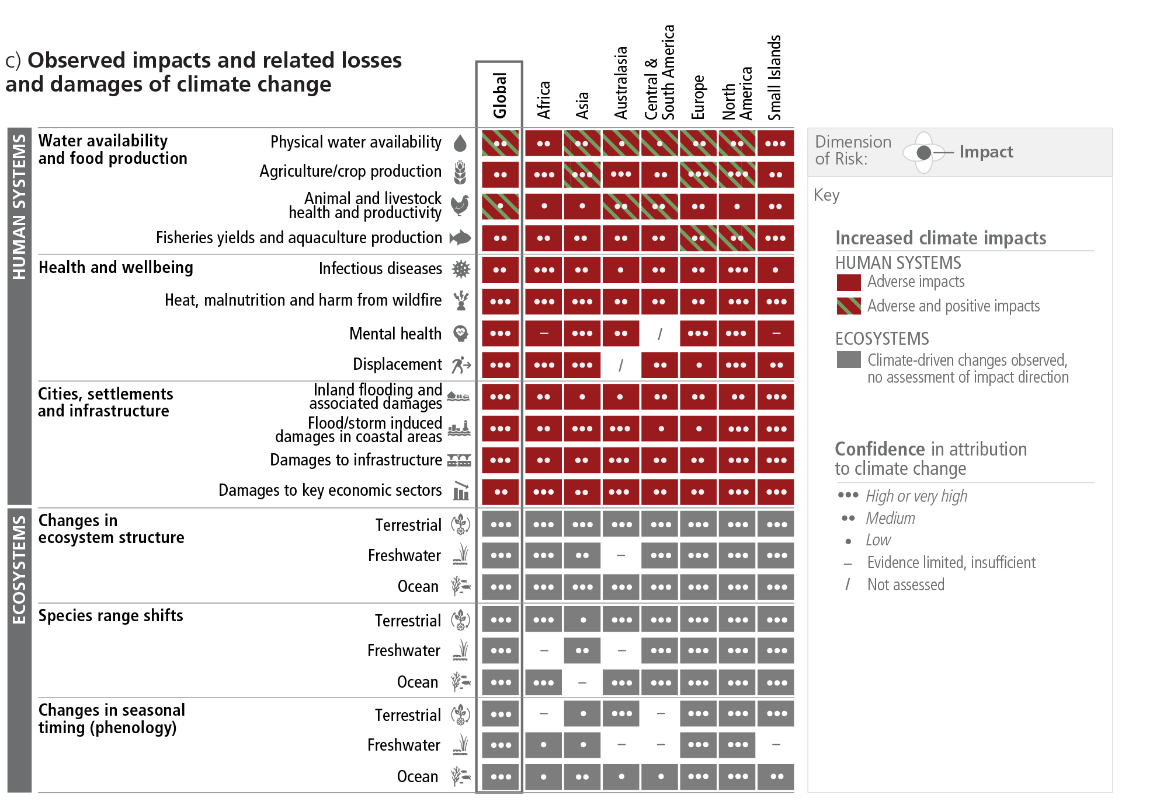
What is the scientific consensus on climate change impacts?
What we do and don’t know
https://www.ipcc.ch/report/ar6/syr/figures/figure-2-3
https://www.ipcc.ch/report/ar6/wg1/downloads/report/IPCC_AR6_WGI_SPM.pdf

Slide 19
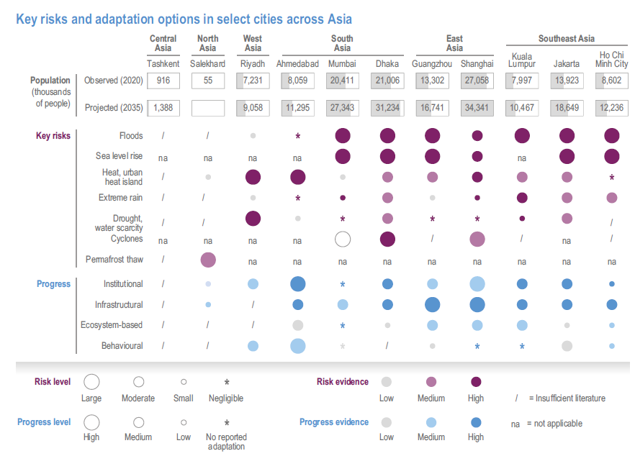
What is the scientific consensus on climate change impacts?
What we do and don’t know
https://www.ipcc.ch/report/ar6/wg2/downloads/report/IPCC_AR6_WGII_FullReport.pdf
[Pg 1501]

Slide 20
What is the scientific consensus on climate change impacts?
What we do and don’t know
Climate Change Certainty in Asia
Observations show a decreasing
trend of the South Asian summer monsoon precipitation during
the second half of the 20th century (high confidence
Globally, China and India have the highest AALs associated with
riverine floods, with a magnitude of 13 and 6 billion USD, respectively.
There is an increased flood risk for habitations on the deltas …, globally exposing 9.3% more people annually to riverine flooding… .
[pg. 1465, 1500]
Global assessments identify Asia as the most exposed region to SLR.
Globally, there is high confidence that the proportion of intense
tropical cyclones is expected to increase despite the total number of tropical cyclones being expected to decrease or remain unchanged (Arias et al., 2021), especially in Southeast and East Asia … .
[pg. 1499, 1500]
Annual surface wind speeds have been decreasing in Asia since the
1950s (high confidence).
The observed changes in the frequency of sand and dust storms vary from region to region in Asia (medium confidence).
West Asia has witnessed more frequent and intensified dust storms affecting Iran and Persian Gulf countries in recent decades (medium confidence)
[pg. 1465]
Rising temperatures increase the likelihood of the threat of heatwaves across Asia, droughts in arid and semiarid areas of West, Central and South Asia, delays and weakening of the monsoon circulation in South Asia, … (medium confidence).
In East Asia wet snow accretion enhanced by global warming often causes damage to electric power lines
[pg. 1459, 1470]
Under regional projections for North Asia, warmer climate will increase forest fire severity by the late 21st century (medium confidence)
Climate change, human activity, lightning and quality of forest governance and management have increased wildfire severity and area burned in North Asia in recent decades.
[pg. 1477, 1532]
https://www.ipcc.ch/report/ar6/wg2/downloads/report/IPCC_AR6_WGII_FullReport.pdf

Slide 21
Questions?
07
Go on, ask one!

Slide 22

Send me an Email!
Brandon Katz
Brandon.Katz@KatRisk.com
https://www.katrisk.com/

